Slide 1
Completion talk
Yamni Mohan, M.Sc
Supervisors: Sagar; Katya

Slide 2
Experimental Chapter 1
Examined the orientation biases in the superior colliculus.

Slide 3
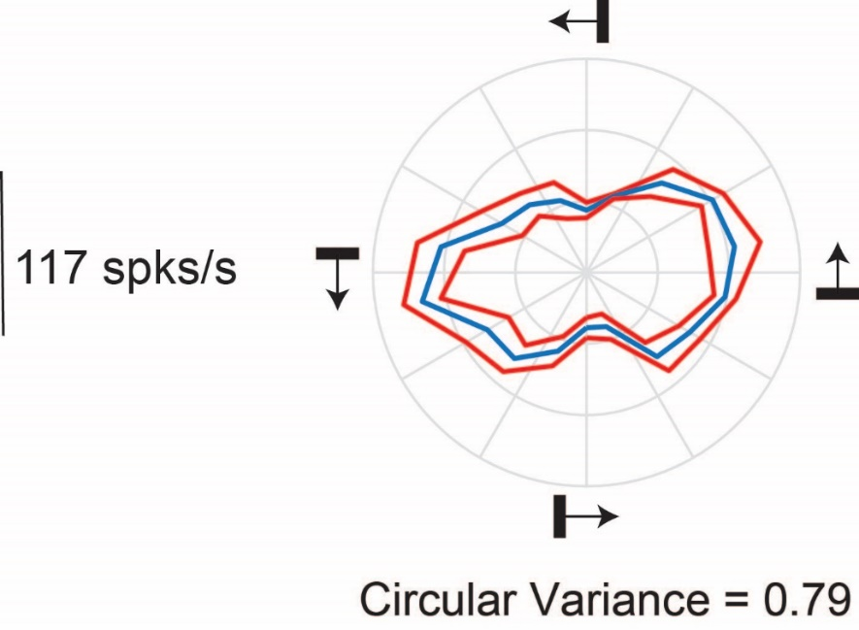
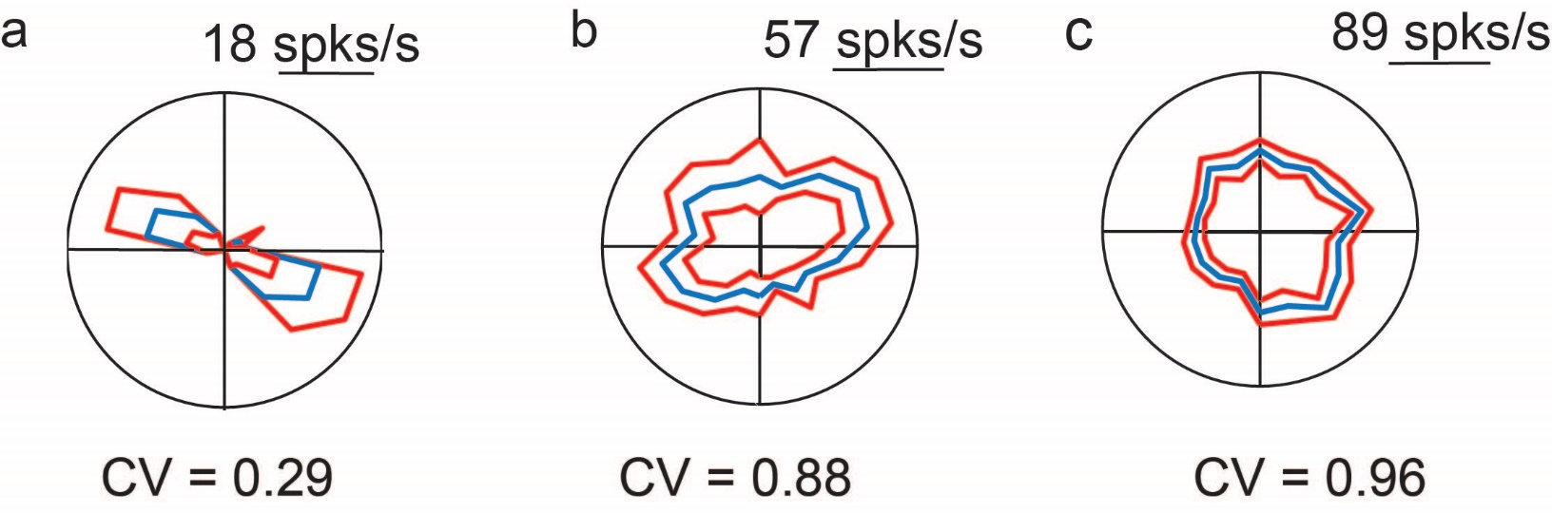
Orientation biases in the tree shrew SC

Slide 4
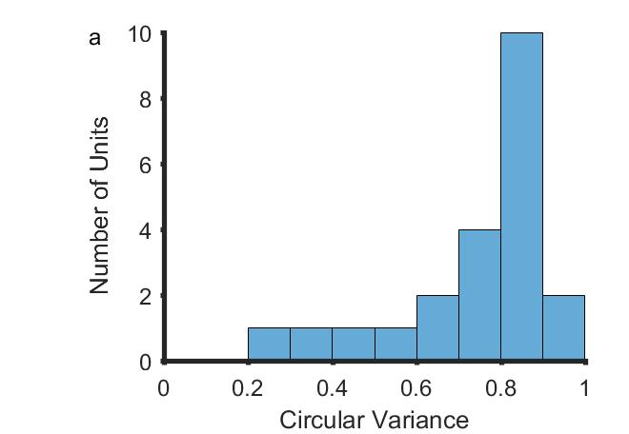
Most neurons are orientation biased
n=22
Better tuned for orientation

Slide 5
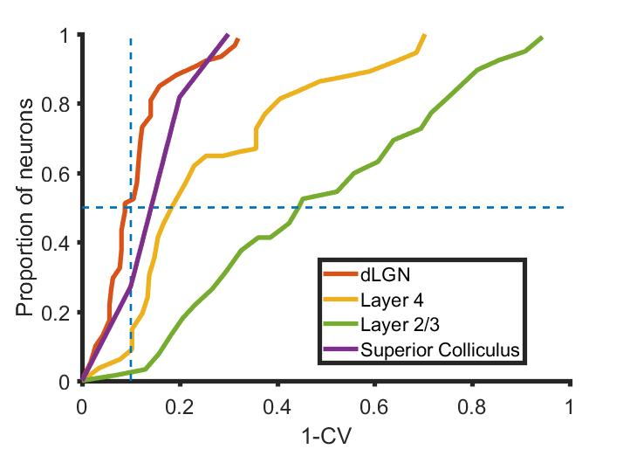
Small biases to orientation when tested with gratings

Slide 6
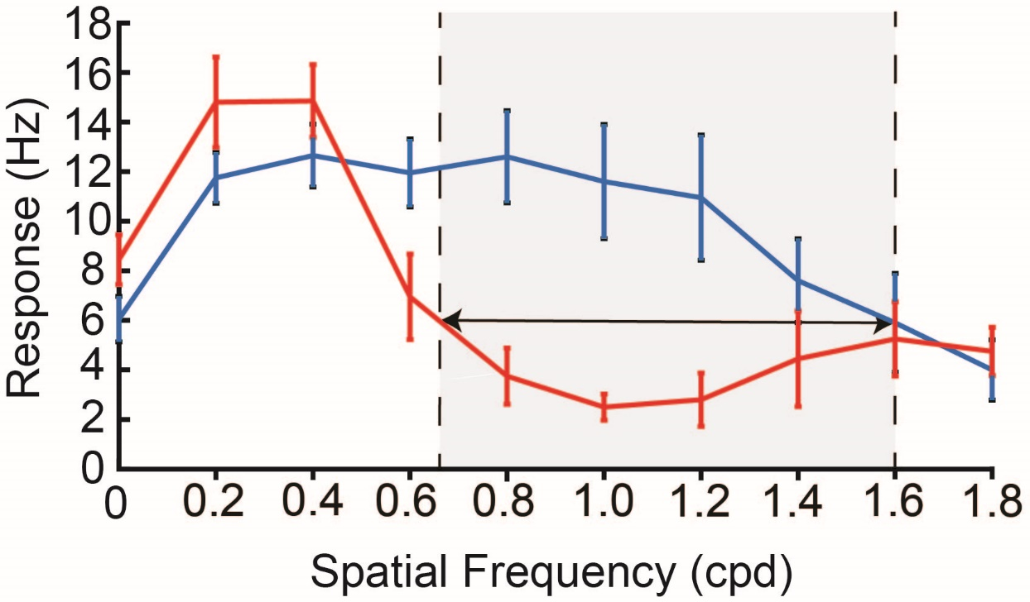
Orientation biases are sharpest at spatial frequencies >> than the optimum
median difference= 0.4 cpd;
Wilcoxon Signed Rank test
z=3.15; p=0.0008

Slide 7
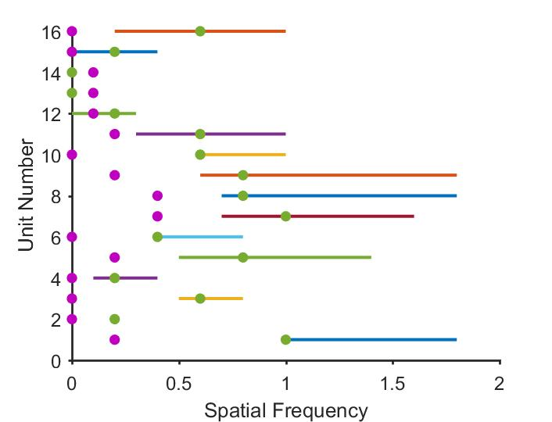
Orientation biases are sharpest at spatial frequencies >> than the optimum
median difference= 0.4 cpd;
Wilcoxon Signed Rank test
z=3.31; p=0.0005

